Slide 1
Integration Testing

Slide 2
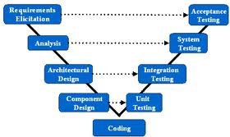
Overview of Testing Types

Slide 3
Integration Testing
Testing the interaction between dependent classes
Occurs after unit testing and before system testing
Black-box or white-box?
IEEE 829 definition
3.1.14 integration testing: Testing in which software components, hardware components, or both are combined and tested to evaluate the interaction among them. This term is commonly used for both the integration of components and the integration of entire systems.

Slide 4
Inputs to Integration Tests
What do you suppose are inputs to Integration Testing?

Slide 5
Some Inputs
Design Information
Class Diagram
Sequence Diagrams
CRC (Class Responsibility and Collaboration)
Call hierarchies
Completed source code
Integration tests require more than one component/class to be coded

Slide 6
Initialization, Frequency and Duration
How soon can we start integration testing?
How often do we do integration testing?
How long does it last?

Slide 7
Four Integration Strategies
Big Bang
Top-Down
Bottom-Up
Sandwich

Slide 8
Big Bang
Left over from hard-core traditional waterfall methods
Wait until all classes have been developed
Now try to integrate them and test them
Issues
The testing occurs way to late in the SDLC
Unexpected behavior is difficult to isolate to it’s root cause

Slide 9
Top-Down
Start at the top of the call hierarchy
Stub in next level down calls
Work our way to the bottom of the call stack
Issues
Lots of scaffolding (stubs)
Significant constraints on the order of implementation
Stubs restrict range of data for testing
Stubs may produce incorrect results

Slide 10
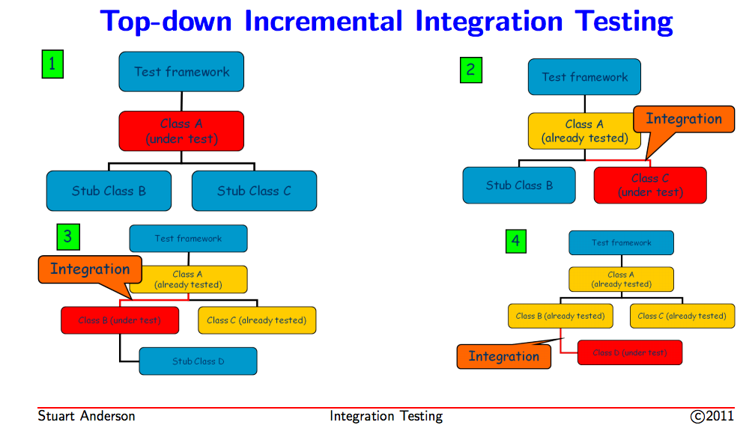
Top-Down Integration Testing

Slide 11
Bottom-Up
Start at the leaf nodes of the call hierarchy and work up
Advantages
Eliminates stubs
Issues
Introduces “drivers” but they are easier than stubs

Slide 12
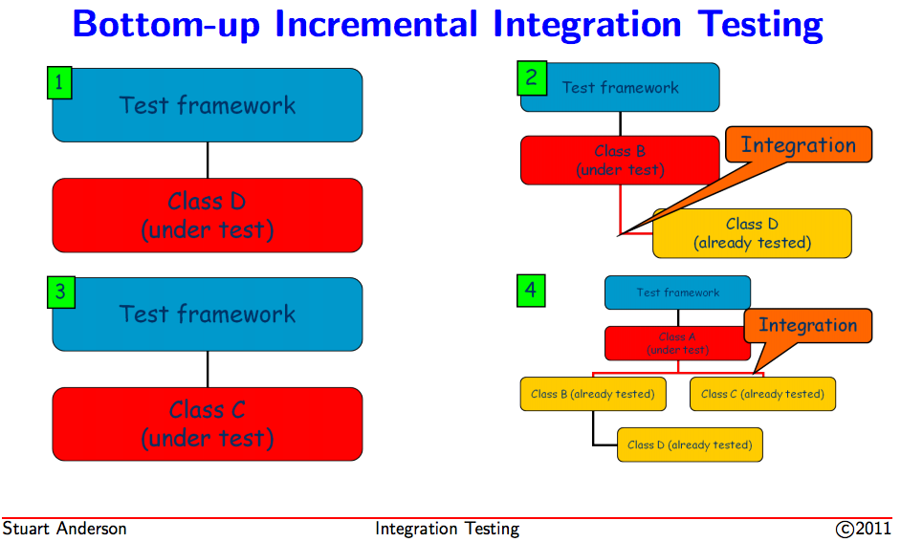
Bottom-Up Integration Testing

Slide 13
Sandwich Integration Testing
This is a hybrid approach that mixes top-down with bottom-up
Selectively choose classes from both ends of the spectrum and work towards the middle

Slide 14
Summary
Integration tests the interfaces between classes/components of the system
Uses a variety of inputs to create and execute integration tests
There are four strategies, three of them still good
Includes primarily white-box testing approaches

